Slide 1
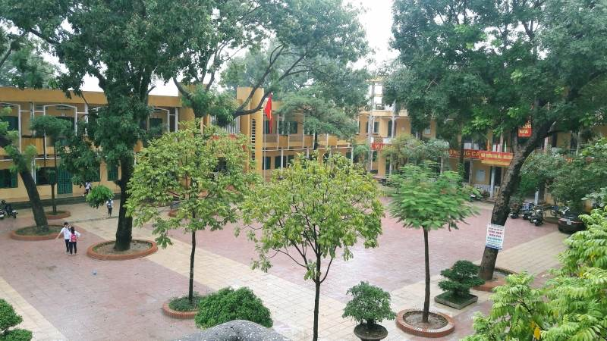
Welcome to our
English lesson!

Slide 2

Warm up
Flycam

Slide 3

Warm up
Watch a video about the flycam and answer the questions.
What can it do?
What do you think about it?

Slide 4
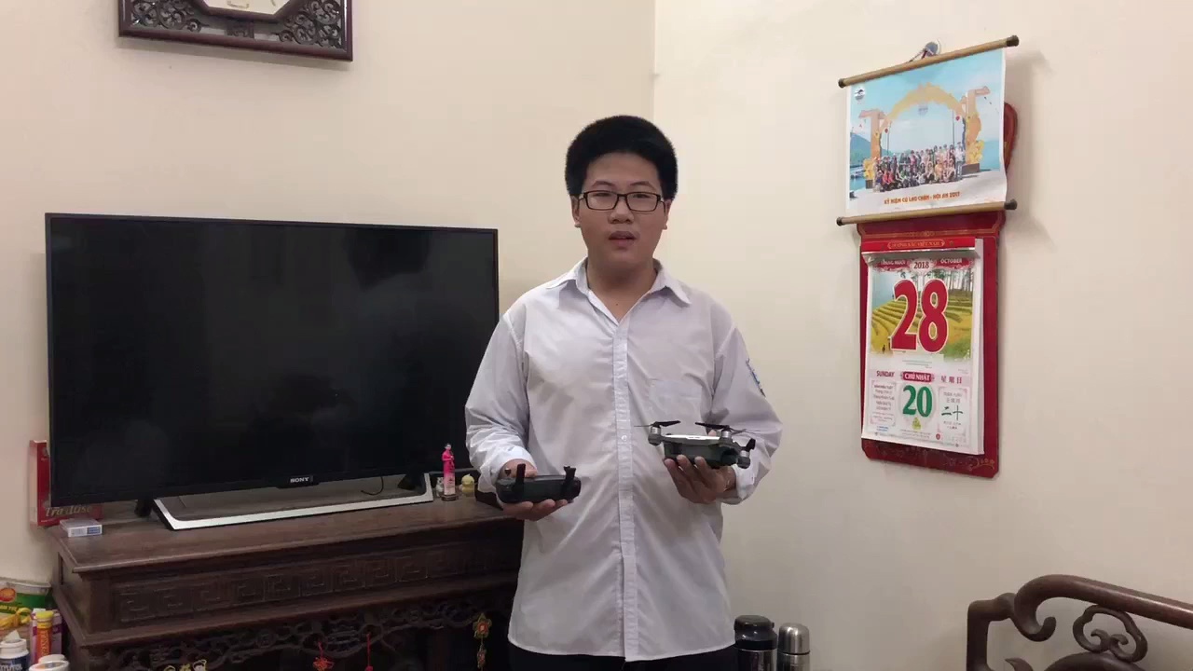

Slide 5

Tuesday, November 27, 2018
English 10
Unit 5: INVENTIONS
Speaking
Period 43:
Unique inventions

Slide 6

Activity 1: A Model Dialogue.

Slide 7
Listen and complete the dialogue.
Practise the dialogue in pairs.
Mary: What’s that machine, Linda? It looks like (1) ………
with wings.
Linda: It’s a flycam. I’ve just bought it.
Mary: Flycam? What’s it used for?
Linda: Well … It’s used for (2) ……………………………………..
from a height and distance.
Mary: Really? For example?
Linda: You can take photos of (3) …………………………………
from your house.
Mary: Fantastic. Does that mean I can see a place of interest
without going there and (4) …………………………… ?
Linda: That’s right.
a toy car
taking photos and videos
a river or a mountain
save lots of money
Hoai Duc A High School

Slide 8



Intonation
Feelings
Really?
Fantastic!
That’s right.

Slide 9
Practise the dialogue in pairs.
Mary: What’s that machine, Linda? It looks like a toy car
with wings.
Linda: It’s a Flycam. I’ve just bought it.
Mary: Flycam? What’s it used for?
Linda: Well … It’s used for taking photos and videos from a height and distance.
Mary: Really? For example?
Linda: You can take photos of a river or a mountain from your house.
Mary: Fantastic. Does that mean I can see a place of interest without going there and save lots of money.
Linda: That’s right.

Slide 10
Information about the flycam.
Information included | Sentences/ Structures used in the dialogue
Name
Origin
Characteristics
Use
Benefits/ Advantages
Disadvantages
√
It’s a flycam.
x
√
It looks like a toy car with wings.
√
It’s used for taking photos and videos from a height and distance.
√
I can see a place of interest without going there and save lots of money.
x

Slide 11
- It can help …
- It’s …
It’s a /an ....
It’s called ...
Name
Benefits
An invention
It looks like ...
It is similar to ...
Characteristics
Use(s)
It is used for +V-ing
We can use it to ...

Slide 12
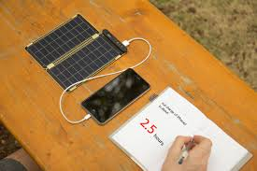
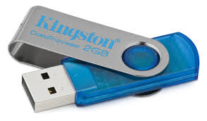
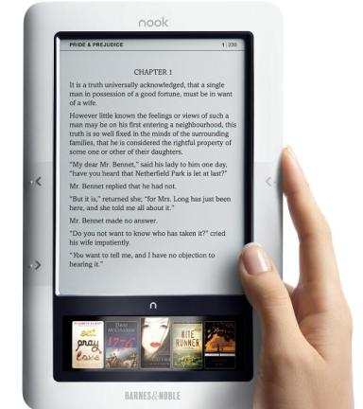
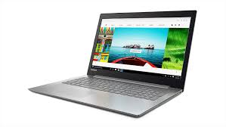
Activity 2: Discuss the inventions with your friends and complete the tables.
1
2
4
3

Slide 13
Activity 2: Discuss the inventions with your friends and complete the tables.
 | Information
Name of invention
Characteristics
Use(s)
Benefits

Slide 14
Characteristics: small, portable
Portable solar charger
Use: charge mobile devices
Benefits:
- not dependent on electricity
easy to carry
not costly
- environmentally-friendly

Slide 15
Characteristics: small, portable
Use:
store data (documents, audio or video files)
Benefits:
USB stick
- easy to use
easy to transport files
easy to carry
not costly

Slide 16
Characteristics:
small, thin, light, portable
Ebook reader
Use:
store hundreds or thousands of books & documents
Benefits:
environmentally
-friendly
(no need of paper)
easy to carry, easy to use
easy to connect with other devices

Slide 17
Characteristics:
small, thin, light, portable
Benefits:
Uses:
Laptop
- easy to carry
easy to use without any
additional devices
easy to access the
Internet through Wi-fi
browse webs
write words
entertain
communicate

Slide 18
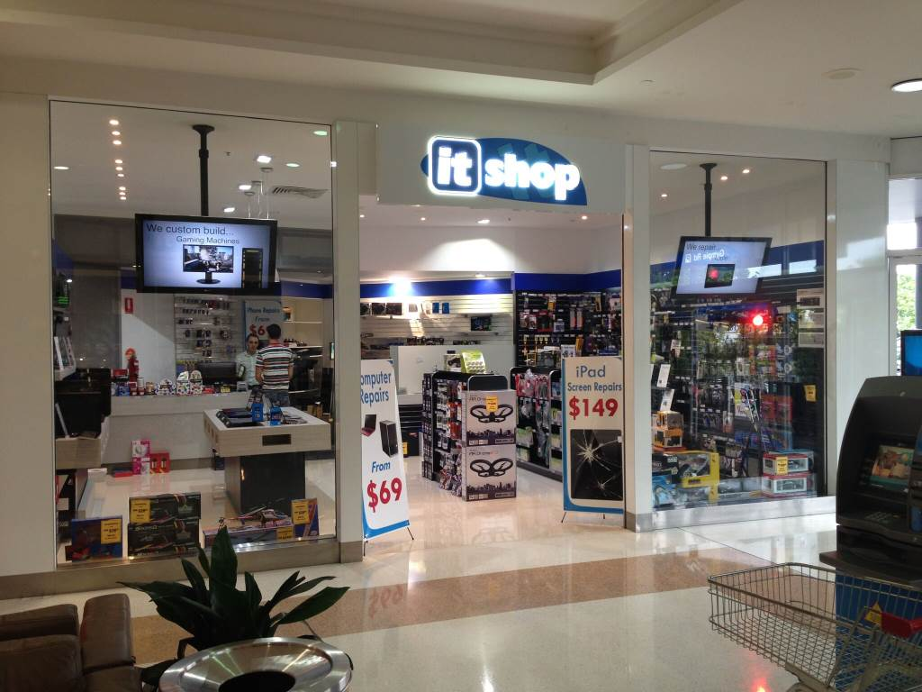
Activity 3: Work in pairs. Make a dialogue about a unique invention.
You are at an IT shop: - Student A: The customer wants to buy an IT product and asks questions about the product. - Student B: The shop keeper answers the questions about the product.

Slide 19
Activity 3: Work in pairs. Make a dialogue about a unique invention.
You are at an IT shop: - Student A: The customer wants to buy an IT product and asks questions about the product. - Student B: The shop keeper answers the questions about the product.
1
2
4
3

Slide 20

Activity 4: A Mini Exhibition.
Work in groups of eight.
Think of a product that you want to invent.
Draw your invention and make a small talk to introduce it to the class.
(5 minutes to draw and
1 minute to present)

Slide 21
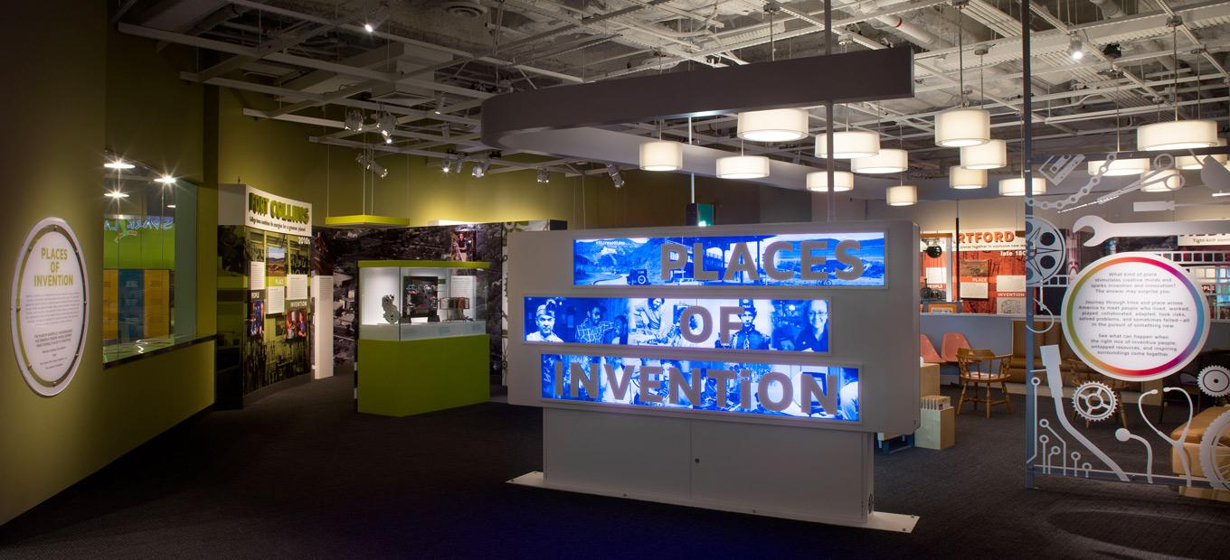
Welcome to our exhibition!

Slide 22
Consolidation
Name of invention
Talking about
inventions
Characteristics
Use(s)
Benefits

Slide 23

HOMEWORK
Write a letter to persuade a company to invest money in your invention.
Prepare for Unit 5 - Listening

Slide 24

Thank you for
your attention!
By Ms Huong, English group, Hoai Duc A High School

