Slide 1

Welcome to our class

Slide 2

1. What do you do during your summer holidays
2. Do you do any summer jobs to get money?
3. What job do you want to do?

Slide 3

UNIT 9: CHOOSING A CAREER
Lesson 7: COMMUNICATION AND CULTURE

Slide 4

Vocabulary

Slide 5
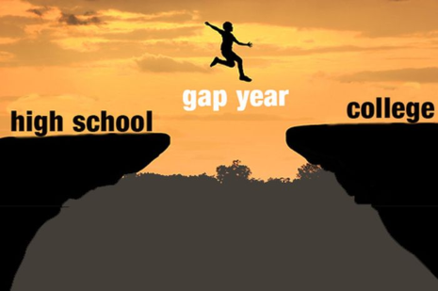
Gap year (n.phr.)
/gæp/
[jiə:]

Slide 6

Adventurous (adj)
/əd'vent∫ərəs/

Slide 7

Expedition (n)
/,ekspə'di∫n/

Slide 8

Horizon (n)
/hə'raizn/
The line at which the earth's surface and the sky appear to meet.

Slide 9
Vocabulary
Expedition (n)
/,ekspə'di∫n/: Cuộc thám hiểm
Horizon (n)
/hə'raizn/ : Chân trời
Adventurous (adj)
/əd'vent∫ərəs/ : Phiêu lưu
Gap year (n.phr.)
/gæp/
[jiə:]
Năm rảnh rỗi của học sinh sau khi tốt nghiệp trung học và trước khi vào đại học

Slide 10
I. COMMUNICATION AND CULTURE

Slide 11
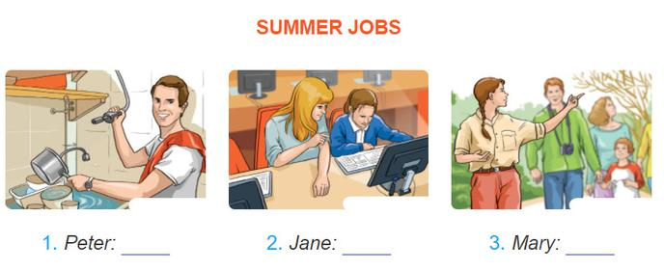
Task 1. Listen to Peter, Jane, and Mary talking about their summer jobs. What does each person do? Write his/her job under each picture.
1. Peter: dishwasher
2. Jane: tutor
3. Mary: tour guide

Slide 12
Task 2. Listen again. Do Peter, Jane, and Mary like their jobs? Why or why not? Tick the correct column and take notes in the table below.
Names | Likes | Doesn't like | Reasons
Peter
Jane
Mary
v
It's a pretty hard job. It's hot in the kitchen.
v
She loves working with the kids. It's fun
v
The work's very interesting.
She has the opportunity to see lots of historical buildings and sights.

Slide 13
Task 3. Work in groups. Imagine you are going to do a summer job. Tell your group about your job and why you like or dislike it.
A: Do you often do summer jobs?
B: ………………………………….
A: What job do you want to do?
B: ………………………………….
A: Why do you like it?
B: …………………………………..

Slide 14
II. CULTURE

Slide 15
Task 1. Read the text about a year out and answer the questions that follow.
1. What would Tom really like to do after securing a place at university?
He would really like a break from the academic world.
2. What are the things that he can do in his gap year?
He could work in a bank or do community work. He might even do something adventurous, such as joining an expedition to a rainforest.
3. What are the benefit that the experience will give him during the gap year?
His experience during a gap year will broaden his horizons and teach him new skills. It may also give him the chance to earn some money.
4. What must Tom check before he decides to take a year out?
→ Before deciding to take a year out, he must make sure that the university will hold his place for him till the following year.
5. What does “the university of life” mean?
→ It means the education one gets from experience in the real world.

Slide 16
Task 2. Discuss the questions with a partner.
1. Do young people take a year out in Viet Nam?
2. Imagine you are allowed to take a year out after finishing school. What will you do in your gap year?

Slide 17

HOMEWORK
Learn all the new words by heart.
Prepare for the new lesson –Looking back

